Slide 1
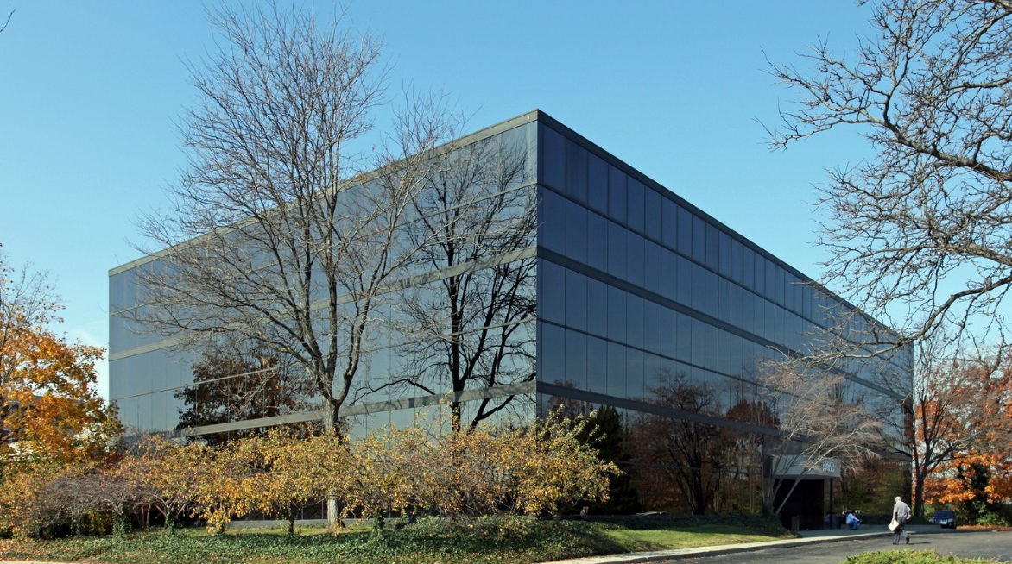
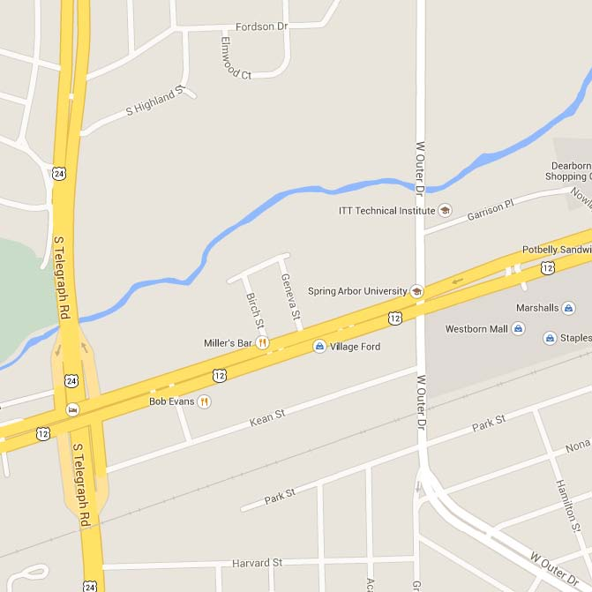
FOR LEASE >
Office Space Available
19853 WEST OUTER DRIVE, DEARBORN, MICHIGAN
> 5,800 Available Square Feet
> Close to Downtown Dearborn
> Ample Parking with Covered Parking Available
> Signage Available
ROBERT BADGERO
248 540 1000 | EXT. 1810
SOUTHFIELD, MI
robert.badgero@colliers.com
STEVEN BADGERO
248 540 1000 | EXT. 1812
SOUTHFIELD, MI
steven.badgero@colliers.com
COLLIERS INTERNATIONAL
2 Corporate Drive, Suite 300
Southfield, MI 48076
www.colliers.com
Colliers International has prepared this document/email for advertising or general information only. Information contained herein has been obtained from the owners or from other sources deemed reliable. We have no reason to doubt its accuracy but regret we cannot guarantee it. All properties subject to change or withdrawal without notice.

Slide 2
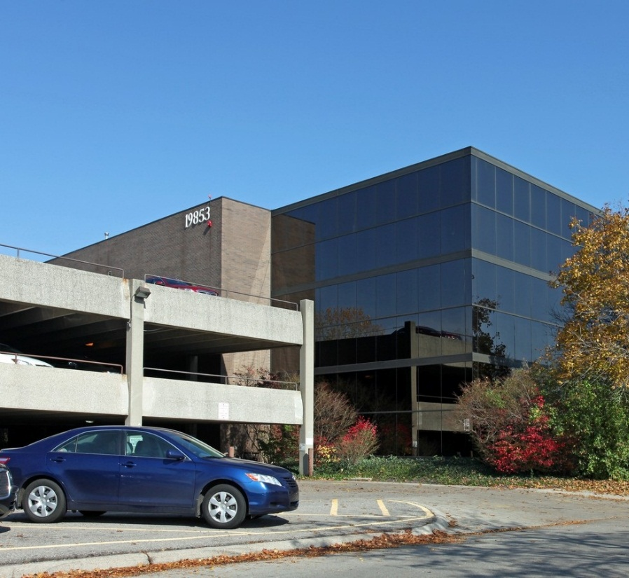
FOR LEASE >
Office Space Available
19853 WEST OUTER DRIVE, DEARBORN, MICHIGAN

